Slide 1

The Forge Website Final Report
Part 2: electric Boogaloo
Samantha Sprecace
In collaboration with
Michael Morrison
Benjamin Volk

Slide 2
Overview Repository
Long-term project
Repository forks for easier management of testing vs production
Communication via Slack or in-person meetings
BSD-3 License
Q&A forum license
No Issue Tracker for current fork of project
Pro User feature
Looking to switch to Open Project

Slide 3


Tasks: July-August 2019
Aesthetics
Make every background the color of the hour's background
Hours page needs transparent nav bar
Make alert boxes/email redirects prettier
Mobile issues
Remove donate buttons on index and contact
Incorrect description on home
Sizing and formatting issues
Text formatting
Logo misplacement
“Open Source” Inquiry
RCOS.io
Blog/status updates
License
Code of conduct
Style guide
Slack link in README
Update Equipment
MySQL

Slide 4
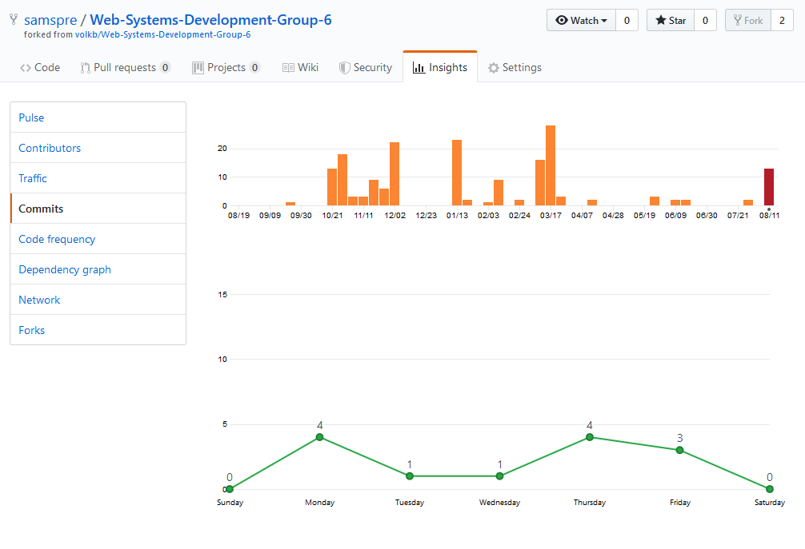
Contributions
Commits and Pull Requests
Learning new languages
PHP, HTML/CSS
Self-taught
Online documentation and experimentation
Communication via Slack
Questions to both of the other developers
Blog Posts!

Slide 5
Notes:
Semi-Successful
I didn’t get all of the work I wanted to get done this sprint, but I definitely have made this website a lot better
I personally don’t have push permissions, so I cannot actually push my changes to the live server
Those in charge are not always available to teach me/accept my changes

